Slide 1
Introduction to artificial intelligence
Technical University of Kosice
Faculty of electrical engineering and informatics
Computer modelling

Slide 2
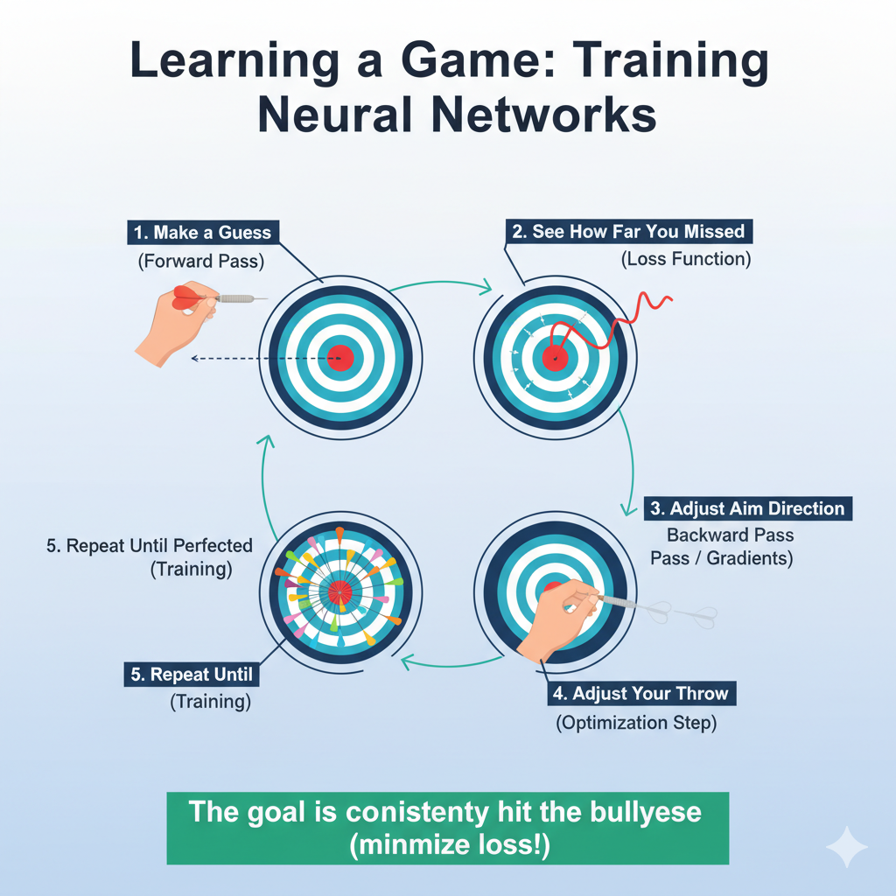

Slide 3

Training of the neural networks
Transfer data
Model
Pull data
Model Module
Forward pass
Data
Predictions
Calculate loss function
Backward pass
Model
Model Module
Calculate Gradients (weights changes)
We already know the Forward pass and loss calculation!

Slide 4
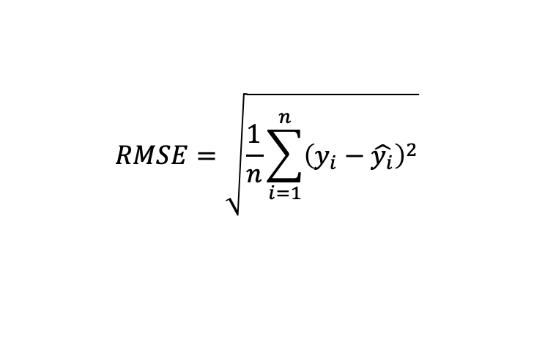
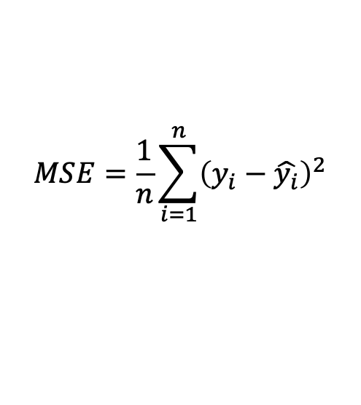
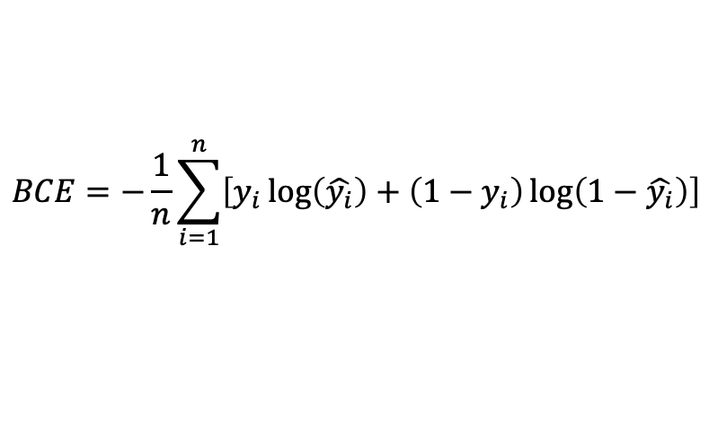
Loss functions
Mean Squared Error loss
Root Mean Squared Error loss
Number of samples
$$RMSE=\sqrt{\frac{1}{n}\sum_{i=1}^{n}{{\left(y_{i}−\hat{y_{i}}\right)}^{2}}}$$
$$MSE=\frac{1}{n}\sum_{i=1}^{n}{{\left(y_{i}−\hat{y_{i}}\right)}^{2}}$$
Prediction
Ground Truth
Binary cross entropy
$$BCE=−\frac{1}{n}\sum_{i=1}^{n}{\left[y_{i}\log\left(\hat{y_{i}}\right)+\left(1−y_{i}\right)\log\left(1−\hat{y_{i}}\right)\right]}$$

Slide 5
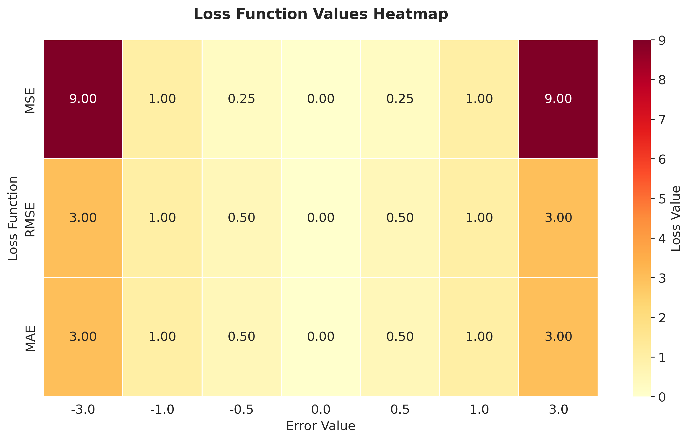
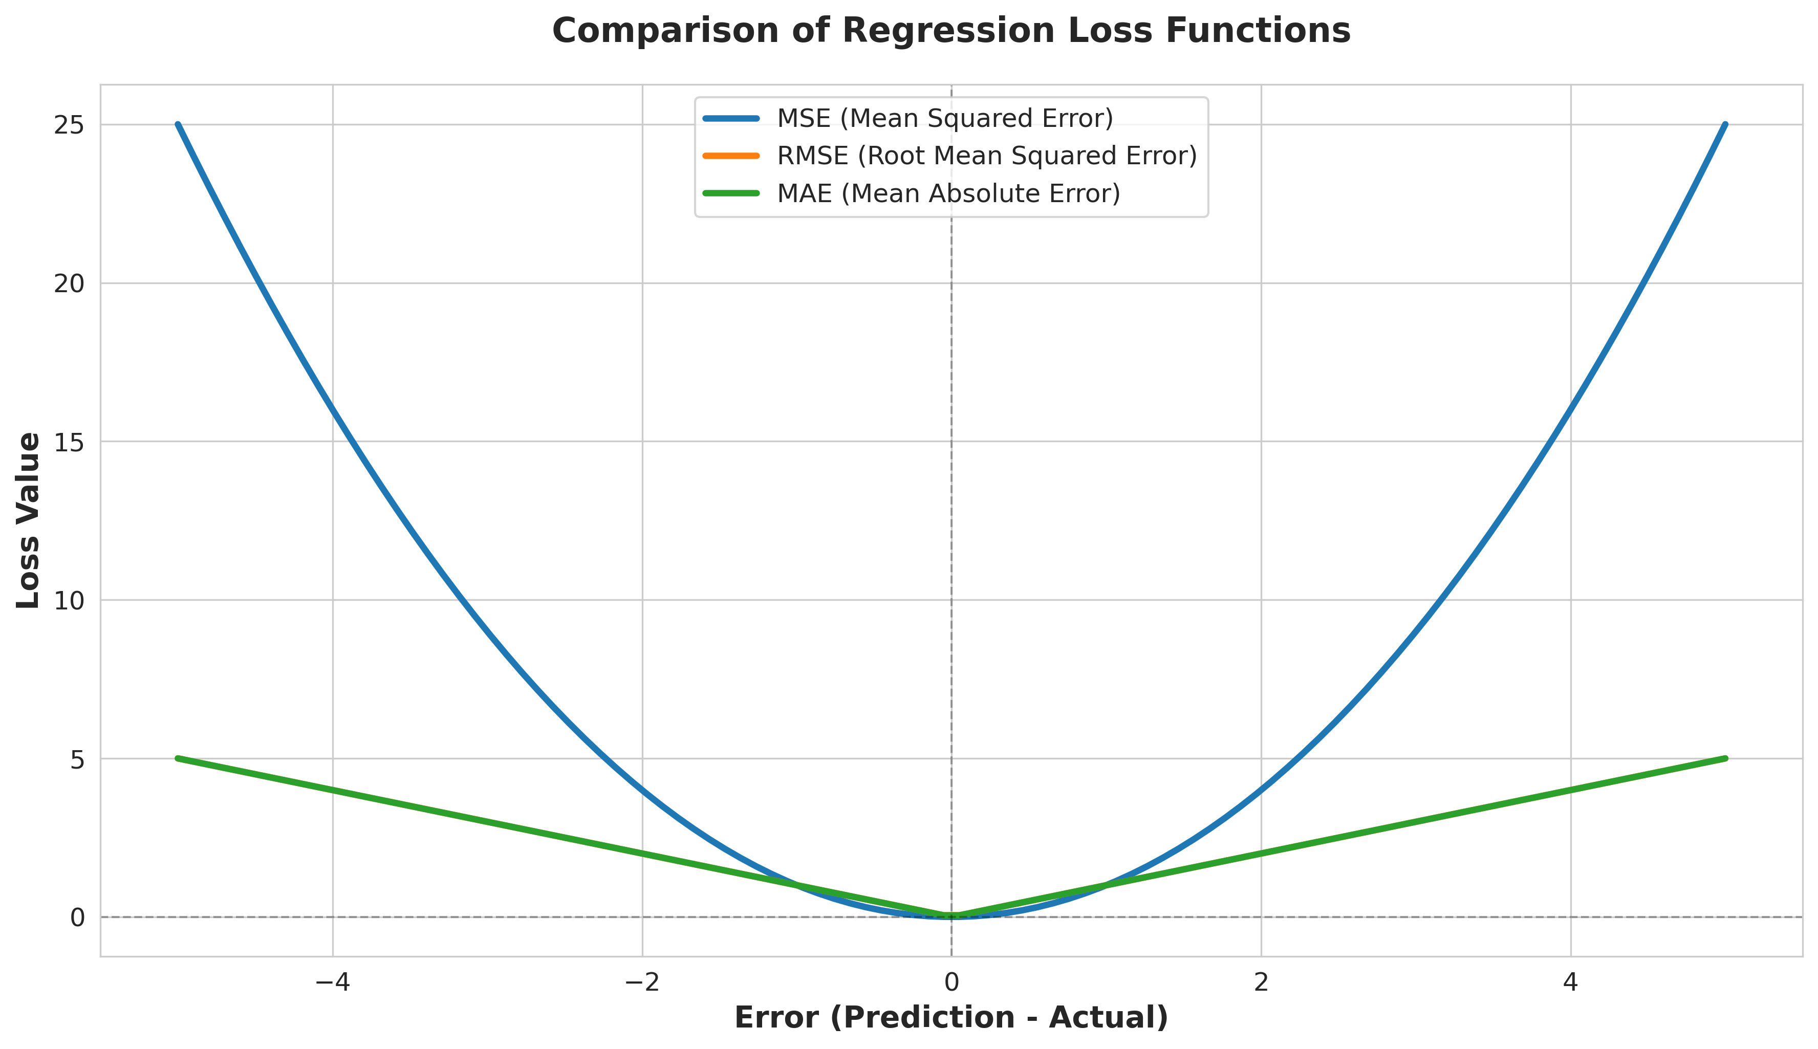

Slide 6
Overfitting issue
What is overfitting?
Weights adapt to training set
Overfitting is like a student who memorizes the answers to a practice test instead of learning the subject

Slide 7
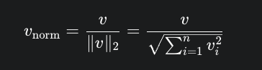
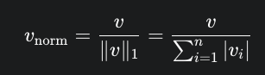
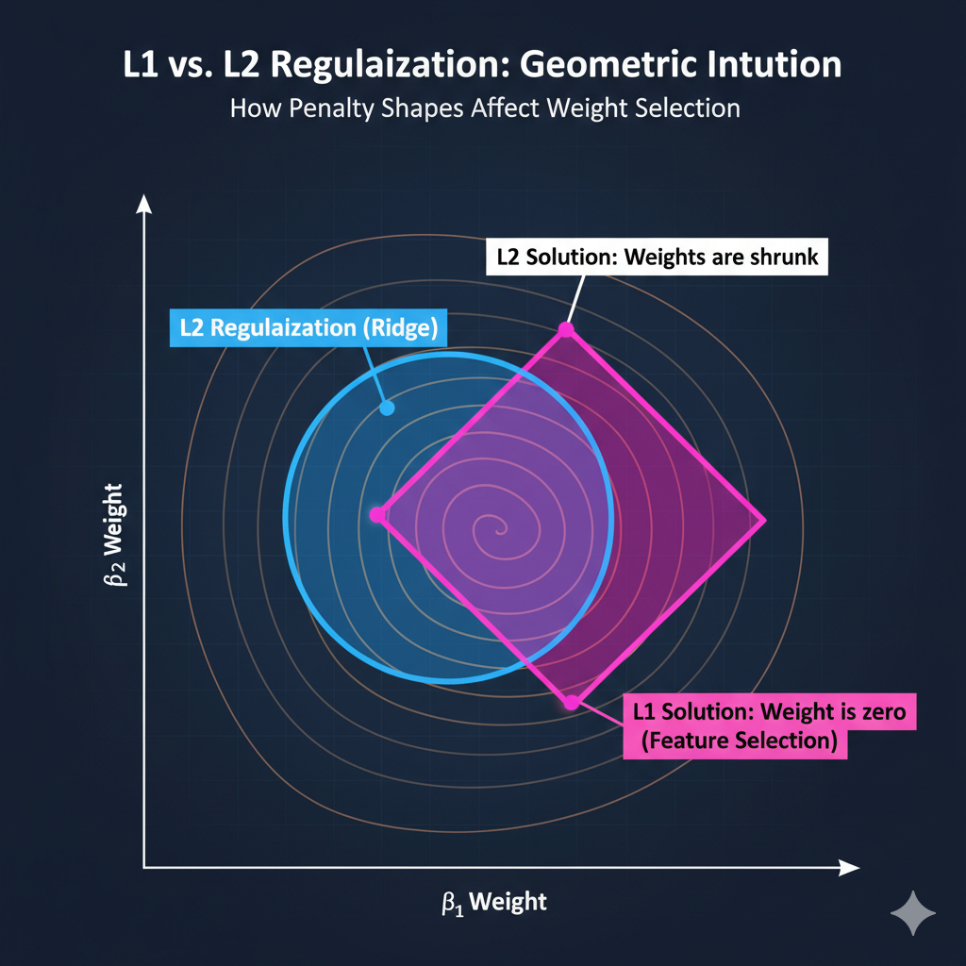
Weight regularization
L2 Regularization (RIDGE)
L1 regularization (LASSO)
Elastic net (l1 + l2)
Dropout (later in the course)
L1 loss introduces sparsity to the weights!
L1 – feature selection
L2 – general normalization

Slide 8
Visualisation of the loss function
Visualisation Demo

Slide 9
Strategy for optimizations: 1. random search

Slide 10

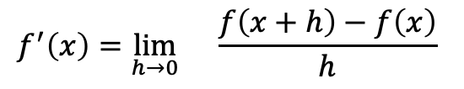
Strategy 2: stochastic gradient descent (sgd)
$$f^{′}\left(x\right)=\lim_{h→0}{}\frac{f\left(x+h\right)−f\left(x\right)}{h}$$
How do we call a vector of partial derivatives?

Slide 11
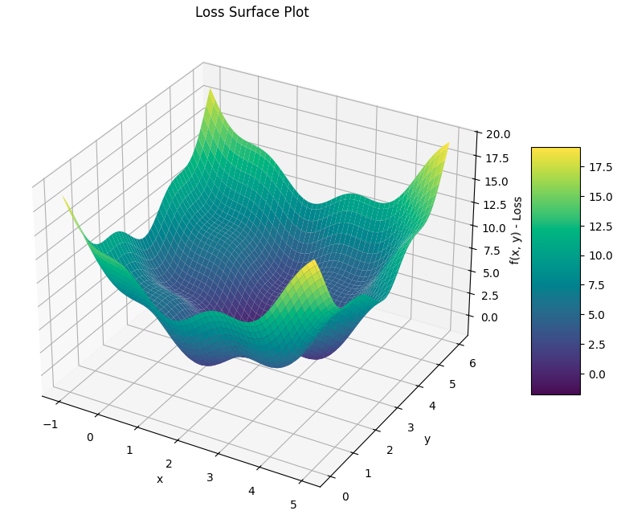
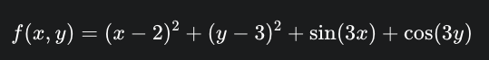
02 lab: optimization

Slide 12
